Slide 1
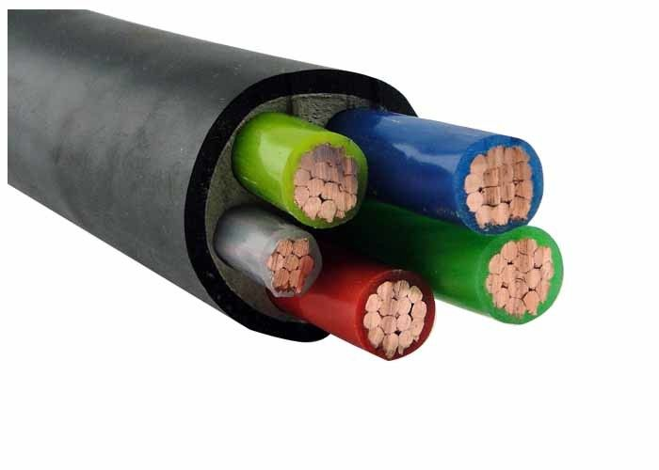
Daily review
CFU 1
Differentiate between a conductor and an insulator, giving one example of each.
Conductors
A material that allows the flow of charge.
Insulators
A material that does not allow the flow of charge.
CFU 2
Look at the electrical cable in the picture. Describe the structure of the cable, mentioning reasons for locations of conductors and insulators.

Slide 2
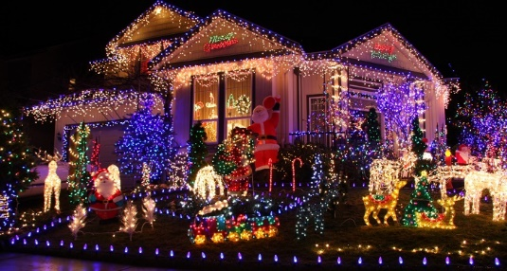

Daily review
CFU 1
Describe how a series circuit is different to a parallel circuit.
Series Circuit
Two or more electrical components connected side by side on the same conducting pathway.
Parallel Circuit
Two or more electrical components connected on different conducting pathways on the same circuit.
CFU 2
State 1 use for a parallel circuit, and 1 for a series circuit.

Slide 3
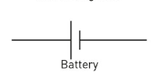

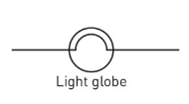
Skill Development
CFU 1
Identify components in circuit
Drawing circuits
Identify the electrical components in the circuit. Start from the power source, place the components in the correct order (considering which are in parallel or series). Connect each component with connecting wires
CFU 2
Series or parallel?
CFU 3
Draw components in order.
Draw a circuit showing a battery, 2 globes in parallel, and a switch that controls both globes.
CFU 4
Connect with wires.
Globe
Globe
Switch
battery
Parallel
Switch controls BOTH globes
CFU 5
Describe the effect on the circuit if the bottom globe blows.

Slide 4
Making Simple Circuits Year 9 Physics

Slide 5
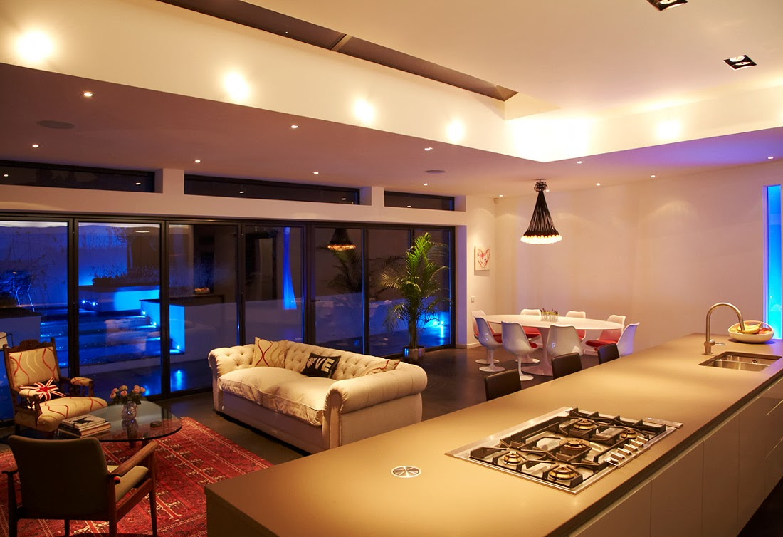
Learning Objectives
CFU
What are we going to learn today?
Draw and construct simple circuit diagrams
Activate Prior Knowledge
Why is a house wired in parallel?
Why would it not be logical to wire up the lights and appliances of a house in series?

Slide 6
Skill Development
CFU 1
Identify components in circuit.
Drawing circuits
Identify the electrical components in the circuit. Start from the power source, place the components in the correct order (considering which are in parallel or series). Connect each component with connecting wires
CFU 2
Series or parallel?
CFU 3
Draw components in order.
A circuit that has a battery, a switch and one light bulb connected in series.
CFU 4
Connect with wires.
CFU 5
Build your circuit and document observations.

Slide 7
Skill Development
CFU 1
Identify components in circuit.
Drawing circuits
Identify the electrical components in the circuit. Start from the power source, place the components in the correct order (considering which are in parallel or series). Connect each component with connecting wires
CFU 2
Series or parallel?
CFU 3
Draw components in order.
A circuit that has a battery, a switch and 2 globes in series.
CFU 4
Connect with wires.
CFU 5
Build your circuit and document observations.

Slide 8
Skill Development
CFU 1
Identify components in circuit.
Drawing circuits
Identify the electrical components in the circuit. Start from the power source, place the components in the correct order (considering which are in parallel or series). Connect each component with connecting wires
CFU 2
Series or parallel?
CFU 3
Draw components in order.
A battery, 2 globes in parallel, and a switch controlling both globes.
CFU 4
Connect with wires.
CFU 5
Build your circuit and document observations.

Slide 9
Skill Development
CFU 1
Identify components in circuit.
Drawing circuits
Identify the electrical components in the circuit. Start from the power source, place the components in the correct order (considering which are in parallel or series). Connect each component with connecting wires
CFU 2
Series or parallel?
CFU 3
Draw components in order.
A battery, a globe, a 20 Ohm resistor and a switch in series.
CFU 4
Connect with wires.
CFU 5
Build your circuit and document observations.

Slide 10
Skill Development
CFU 1
Identify components in circuit.
Drawing circuits
Identify the electrical components in the circuit. Start from the power source, place the components in the correct order (considering which are in parallel or series). Connect each component with connecting wires
CFU 2
Series or parallel?
CFU 3
Draw components in order.
A battery with a globe and a 20 Ohm resistor in parallel, and a switch controlling the globe.
CFU 4
Connect with wires.
CFU 5
Build your circuit and document observations.

Slide 11
Skill Development
CFU 1
Identify components in circuit.
Drawing circuits
Identify the electrical components in the circuit. Start from the power source, place the components in the correct order (considering which are in parallel or series). Connect each component with connecting wires
CFU 2
Series or parallel?
CFU 3
Draw components in order.
A battery with 2 globes in parallel, each globe controlled by a switch.
CFU 4
Connect with wires.
CFU 5
Build your circuit and document observations.

Slide 12
Independent Practice
If all circuits are completed with time to spare complete the following questions in Oxford Science 9.
Questions 1-5 Page 107
Questions 1-4 Page 109

